Slide 1

Dive into Deep Learning
Chapter 2:
Preliminaries Probability

Slide 2
Contents
Data Manipulation
Reading the Dataset
Handling Missing Data
Linear Algebra
Scalars
Automatic Differentiation
Probability
Calculus
Documentation
Data Preprocessing
Conversion to the Tensor Format
Matrices
Tensors
Getting Started
Operations
Broadcasting Mechanism
Indexing and Slicing
Saving Memory
Conversion to Other Python Objects
Vectors
Basic Properties of Tensor Arithmetic
Derivatives and Differentiation
Partial Derivatives
Gradients
Chain Rule
A Simple Example
Backward for Non-Scalar Variables
Detaching Computation
Computing the Gradient of Python Control Flow
Basic Probability Theory
Dealing with Multiple Random Variables
Expectation and Variance
Finding All the Functions and Classes in a Module
Finding the Usage of Specific Functions and Classes
+6 sections
Linear Algebra cont.
Reduction
Dot Products
Matrix-Vector Products
Matrix-Matrix Multiplication
Norms
More on Linear Algebra

Slide 3
Contents
CH2
Data Manipulation
Data Preprocessing
Linear Algebra
Linear Algebra cont.
Calculus
Automatic Differentiation
Probability
Documentation
Getting Started
Reading the Dataset
Scalars
Reduction
Derivatives and Differentiation
A Simple Example
Basic Probability Theory
Finding All the Functions and Classes in a Module
Operations
Handling Missing Data
Vectors
Dot Products
Partial Derivatives
Backward for Non-Scalar Variables
Dealing with Multiple Random Variables
Finding the Usage of Specific Functions and Classes
Broadcasting Mechanism
Conversion to the Tensor Format
Matrices
Matrix-Vector Products
Gradients
Detaching Computation
Expectation and Variance
Indexing and Slicing
Tensors
Matrix-Matrix Multiplication
Chain Rule
Computing the Gradient of Python Control Flow
Saving Memory
Basic Properties of Tensor Arithmetic
Norms
Conversion to Other Python Objects
+6 sections
More on Linear Algebra

Slide 4
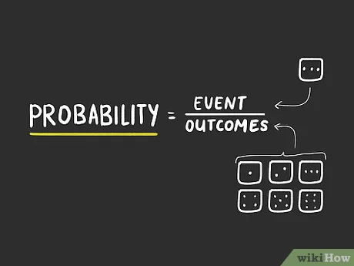
Probability
Machine learning is all about making predictions.
Predict the probability of a patient suffering a heart attack in the next year, given their clinical history.
Anomaly detection.
Reinforcement learning.
Recommender systems.
Probability gives us a formal way of reasoning about our level of certainty.
Src: https://www.wikihow.com/Calculate-Probability

Slide 5
Contents
CH2
Data Manipulation
Data Preprocessing
Linear Algebra
Linear Algebra cont.
Calculus
Automatic Differentiation
Probability
Documentation
Getting Started
Reading the Dataset
Scalars
Reduction
Derivatives and Differentiation
A Simple Example
Basic Probability Theory
Finding All the Functions and Classes in a Module
Operations
Handling Missing Data
Vectors
Dot Products
Partial Derivatives
Backward for Non-Scalar Variables
Dealing with Multiple Random Variables
Finding the Usage of Specific Functions and Classes
Broadcasting Mechanism
Conversion to the Tensor Format
Matrices
Matrix-Vector Products
Gradients
Detaching Computation
Expectation and Variance
Indexing and Slicing
Tensors
Matrix-Matrix Multiplication
Chain Rule
Computing the Gradient of Python Control Flow
Saving Memory
Basic Properties of Tensor Arithmetic
Norms
Conversion to Other Python Objects
+6 sections
More on Linear Algebra

Slide 6

Basic Probability Theory
Say that we cast a die and want to know what the chance is of seeing a 1 rather than another digit.
Formally we state that 1 occurs with probability 1/6.
The only way to investigate the die is by casting it many times and recording the outcomes.
Given these outcomes, we want to investigate the probability of observing each outcome.
For each value, take the individual count for that value and to divide it by the total number of tosses.
As the number of tosses grows this estimate will draw closer and closer to the true underlying probability.

Slide 7
Basic Probability Theory
Import the necessary packages.
%matplotlib inline
from d2l import mxnet as d2l
from mxnet import np, npx
import random
npx.set_np()
Next, we will want to be able to cast the die.
Sampling: the process of drawing examples from probability distributions.
Multinomial distribution: The distribution that assigns probabilities to a number of discrete choices.
You can think of distribution as just an assignment of probabilities to events.

Slide 8
Basic Probability Theory
To draw a single sample, we simply pass in a vector of probabilities.
fair_probs = [1.0 / 6] * 6
np.random.multinomial(1, fair_probs)
The output is another vector of the same length: its value at index $i$ is the number of times the sampling outcome corresponds to $i$.
As with estimating the fairness of a die, we often want to generate many samples from the same distribution.
np.random.multinomial(10,fair_probs)
Calculate the relative frequency as the estimate of the true probability.
counts = np.random.multinomial(1000,fair_probs).astype(np.float32)
counts/1000

Slide 9
Basic Probability Theory
We can also visualize how these probabilities converge over time towards the true probability.
Let us conduct 500 groups of experiments where each group draws 10 samples.
counts = np.random.multinomial(10, fair_probs, size=500)
cum_counts = counts.astype(np.float32).cumsum(axis=0)
estimates = cum_counts / cum_counts.sum(axis=1, keepdims=True)
d2l.set_figsize((6, 4.5))
for i in range(6):
d2l.plt.plot(estimates[:, i].asnumpy(),
label=("P(die=" + str(i + 1) + ")"))
d2l.plt.axhline(y=0.167, color='black', linestyle='dashed')
d2l.plt.gca().set_xlabel('Groups of experiments')
d2l.plt.gca().set_ylabel('Estimated probability')
d2l.plt.legend();
This procedure is as follows:
Create 500 groups, each group draws 10 samples
Calculate the cumulative sum along axis 0 (column axis)
Calculate the sum of each row (axis =1) in the cumulative sum of the previous step
Divide each element of the cumulative sum by the sum of the values of the element’s row
Plot the estimates of each value (element) along all the groups

Slide 10
Basic Probability Theory
This procedure is as follows:
Create 500 groups, each group draws 10 samples
Calculate the cumulative sum along axis 0 (column axis)
Calculate the sum of each row (axis =1) in the cumulative sum of the previous step
Divide each element of the cumulative sum by the sum of the values of the element’s row
Plot the estimates of each value (element) along all the groups
counts = np.random.multinomial(10, fair_probs, size=500)
1
2
3
4
5
6
Group 1
1 | 2 | 2 | 2 | 0 | 3
4 | 1 | 1 | 2 | 2 | 0
3 | 1 | 3 | 0 | 1 | 2
Group 2
Group 3
. . .
Group 498
1 | 2 | 3 | 2 | 0 | 2
2 | 3 | 1 | 1 | 1 | 2
0 | 2 | 1 | 2 | 2 | 3
Group 499
Group 500

Slide 11
Basic Probability Theory
This procedure is as follows:
Calculate the cumulative sum along axis 0 (column axis)
Calculate the sum of each row (axis =1) in the cumulative sum of the previous step
Divide each element of the cumulative sum by the sum of the values of the element’s row
Plot the estimates of each value (element) along all the groups
Create 500 groups, each group draws 10 samples
cum_counts = counts.astype(np.float32).cumsum(axis=0)
1
2
3
4
5
6
Group 1
1 | 2 | 2 | 2 | 0 | 3
5 | 3 | 3 | 4 | 2 | 3
8 | 4 | 6 | 4 | 3 | 5
Group 2
Group 3
. . .
Group 498
839 | 847 | 891 | 797 | 827 | 779
841 | 850 | 892 | 798 | 828 | 781
841 | 852 | 893 | 800 | 830 | 784
Group 499
Group 500

Slide 12
Basic Probability Theory
This procedure is as follows:
Calculate the cumulative sum along axis 0 (column axis)
Calculate the sum of each row (axis =1) in the cumulative sum of the previous step
Divide each element of the cumulative sum by the sum of the values of the element’s row
Plot the estimates of each value (element) along all the groups
Create 500 groups, each group draws 10 samples
estimates = cum_counts / cum_counts.sum(axis=1, keepdims=True)
1
2
3
4
5
6
Group 1
1 | 2 | 2 | 2 | 0 | 3
5 | 3 | 3 | 4 | 2 | 3
8 | 4 | 6 | 4 | 3 | 5
10
20
30
Group 2
Group 3
. . .
. . .
Group 498
839 | 847 | 891 | 797 | 827 | 779
841 | 850 | 892 | 798 | 828 | 781
841 | 852 | 893 | 800 | 830 | 784
4980
4990
5000
Group 499
Group 500

Slide 13
Basic Probability Theory
This procedure is as follows:
Calculate the cumulative sum along axis 0 (column axis)
Calculate the sum of each row (axis =1) in the cumulative sum of the previous step
Divide each element of the cumulative sum by the sum of the values of the element’s row
Plot the estimates of each value (element) along all the groups
Create 500 groups, each group draws 10 samples
estimates = cum_counts / cum_counts.sum(axis=1, keepdims=True)
1
2
3
4
5
6
Group 1
1 | 2 | 2 | 2 | 0 | 3
5 | 3 | 3 | 4 | 2 | 3
8 | 4 | 6 | 4 | 3 | 5
10
20
30
Group 2
Group 3
. . .
. . .
Group 498
839 | 847 | 891 | 797 | 827 | 779
841 | 850 | 892 | 798 | 828 | 781
841 | 852 | 893 | 800 | 830 | 784
4980
4990
5000
Group 499
Group 500

Slide 14
Basic Probability Theory
This procedure is as follows:
Calculate the cumulative sum along axis 0 (column axis)
Calculate the sum of each row (axis =1) in the cumulative sum of the previous step
Divide each element of the cumulative sum by the sum of the values of the element’s row
Plot the estimates of each value (element) along all the groups
Create 500 groups, each group draws 10 samples
estimates = cum_counts / cum_counts.sum(axis=1, keepdims=True)
1
2
3
4
5
6
Group 1
0.1 | 2 | 2 | 2 | 0 | 3
5 | 3 | 3 | 4 | 2 | 3
8 | 4 | 6 | 4 | 3 | 5
10
20
30
Group 2
Group 3
. . .
. . .
Group 498
839 | 847 | 891 | 797 | 827 | 779
841 | 850 | 892 | 798 | 828 | 781
841 | 852 | 893 | 800 | 830 | 784
4980
4990
5000
Group 499
Group 500

Slide 15
Basic Probability Theory
This procedure is as follows:
Calculate the cumulative sum along axis 0 (column axis)
Calculate the sum of each row (axis =1) in the cumulative sum of the previous step
Divide each element of the cumulative sum by the sum of the values of the element’s row
Plot the estimates of each value (element) along all the groups
Create 500 groups, each group draws 10 samples
estimates = cum_counts / cum_counts.sum(axis=1, keepdims=True)
1
2
3
4
5
6
Group 1
0.1 | 0.2 | 2 | 2 | 0 | 3
5 | 3 | 3 | 4 | 2 | 3
8 | 4 | 6 | 4 | 3 | 5
10
20
30
Group 2
Group 3
. . .
. . .
Group 498
839 | 847 | 891 | 797 | 827 | 779
841 | 850 | 892 | 798 | 828 | 781
841 | 852 | 893 | 800 | 830 | 784
4980
4990
5000
Group 499
Group 500

Slide 16
Basic Probability Theory
This procedure is as follows:
Calculate the cumulative sum along axis 0 (column axis)
Calculate the sum of each row (axis =1) in the cumulative sum of the previous step
Divide each element of the cumulative sum by the sum of the values of the element’s row
Plot the estimates of each value (element) along all the groups
Create 500 groups, each group draws 10 samples
estimates = cum_counts / cum_counts.sum(axis=1, keepdims=True)
1
2
3
4
5
6
Group 1
0.1 | 0.2 | 0.2 | 2 | 0 | 3
5 | 3 | 3 | 4 | 2 | 3
8 | 4 | 6 | 4 | 3 | 5
10
20
30
Group 2
Group 3
. . .
. . .
Group 498
839 | 847 | 891 | 797 | 827 | 779
841 | 850 | 892 | 798 | 828 | 781
841 | 852 | 893 | 800 | 830 | 784
4980
4990
5000
Group 499
Group 500

Slide 17
Basic Probability Theory
This procedure is as follows:
Calculate the cumulative sum along axis 0 (column axis)
Calculate the sum of each row (axis =1) in the cumulative sum of the previous step
Divide each element of the cumulative sum by the sum of the values of the element’s row
Plot the estimates of each value (element) along all the groups
Create 500 groups, each group draws 10 samples
estimates = cum_counts / cum_counts.sum(axis=1, keepdims=True)
1
2
3
4
5
6
Group 1
0.1 | 0.2 | 0.2 | 0.2 | 0 | 3
5 | 3 | 3 | 4 | 2 | 3
8 | 4 | 6 | 4 | 3 | 5
10
20
30
Group 2
Group 3
. . .
. . .
Group 498
839 | 847 | 891 | 797 | 827 | 779
841 | 850 | 892 | 798 | 828 | 781
841 | 852 | 893 | 800 | 830 | 784
4980
4990
5000
Group 499
Group 500

Slide 18
Basic Probability Theory
This procedure is as follows:
Calculate the cumulative sum along axis 0 (column axis)
Calculate the sum of each row (axis =1) in the cumulative sum of the previous step
Divide each element of the cumulative sum by the sum of the values of the element’s row
Plot the estimates of each value (element) along all the groups
Create 500 groups, each group draws 10 samples
estimates = cum_counts / cum_counts.sum(axis=1, keepdims=True)
1
2
3
4
5
6
Group 1
0.1 | 0.2 | 0.2 | 0.2 | 0.0 | 3
5 | 3 | 3 | 4 | 2 | 3
8 | 4 | 6 | 4 | 3 | 5
10
20
30
Group 2
Group 3
. . .
. . .
Group 498
839 | 847 | 891 | 797 | 827 | 779
841 | 850 | 892 | 798 | 828 | 781
841 | 852 | 893 | 800 | 830 | 784
4980
4990
5000
Group 499
Group 500

Slide 19
Basic Probability Theory
This procedure is as follows:
Calculate the cumulative sum along axis 0 (column axis)
Calculate the sum of each row (axis =1) in the cumulative sum of the previous step
Divide each element of the cumulative sum by the sum of the values of the element’s row
Plot the estimates of each value (element) along all the groups
Create 500 groups, each group draws 10 samples
estimates = cum_counts / cum_counts.sum(axis=1, keepdims=True)
1
2
3
4
5
6
Group 1
.1 | .2 | .2 | .2 | .0 | 0.3
0.25 | 0.15 | 0.15 | 0.2 | 0.1 | 0.15
0.266 | 0.133 | 0.2 | 0.133 | 0.1 | 0.166
10
20
30
Group 2
Group 3
. . .
. . .
We continue until reach last row..
Group 498
0.168 | 0.170 | 0.178 | 0.160 | 0.166 | 0.156
0.168 | 0.170 | 0.178 | 0.159 | 0.165 | 0.156
841 | 852 | 893 | 800 | 830 | 784
4980
4990
5000
Group 499
Group 500

Slide 20
Basic Probability Theory
This procedure is as follows:
Calculate the cumulative sum along axis 0 (column axis)
Calculate the sum of each row (axis =1) in the cumulative sum of the previous step
Divide each element of the cumulative sum by the sum of the values of the element’s row
Plot the estimates of each value (element) along all the groups
Create 500 groups, each group draws 10 samples
estimates = cum_counts / cum_counts.sum(axis=1, keepdims=True)
1
2
3
4
5
6
Group 1
.1 | .2 | .2 | .2 | .0 | 0.3
0.25 | 0.15 | 0.15 | 0.2 | 0.1 | 0.15
0.266 | 0.133 | 0.2 | 0.133 | 0.1 | 0.166
10
20
30
Group 2
Group 3
. . .
. . .
We continue until reach last row..
Group 498
0.168 | 0.170 | 0.178 | 0.160 | 0.166 | 0.156
0.168 | 0.170 | 0.178 | 0.159 | 0.165 | 0.156
0.168 | 0.170 | 0.178 | 800 | 830 | 784
4980
4990
5000
Group 499
Group 500

Slide 21
Basic Probability Theory
This procedure is as follows:
Calculate the cumulative sum along axis 0 (column axis)
Calculate the sum of each row (axis =1) in the cumulative sum of the previous step
Divide each element of the cumulative sum by the sum of the values of the element’s row
Plot the estimates of each value (element) along all the groups
Create 500 groups, each group draws 10 samples
estimates = cum_counts / cum_counts.sum(axis=1, keepdims=True)
1
2
3
4
5
6
Group 1
.1 | .2 | .2 | .2 | .0 | 0.3
0.25 | 0.15 | 0.15 | 0.2 | 0.1 | 0.15
0.266 | 0.133 | 0.2 | 0.133 | 0.1 | 0.166
10
20
30
Group 2
Group 3
. . .
. . .
We continue until reach last row..
Group 498
0.168 | 0.170 | 0.178 | 0.160 | 0.166 | 0.156
0.168 | 0.170 | 0.178 | 0.159 | 0.165 | 0.156
0.168 | 0.170 | 0.178 | 0.16 | 0.166 | 784
4980
4990
5000
Group 499
Group 500

Slide 22
Basic Probability Theory
This procedure is as follows:
Calculate the cumulative sum along axis 0 (column axis)
Calculate the sum of each row (axis =1) in the cumulative sum of the previous step
Divide each element of the cumulative sum by the sum of the values of the element’s row
Plot the estimates of each value (element) along all the groups
Create 500 groups, each group draws 10 samples
estimates = cum_counts / cum_counts.sum(axis=1, keepdims=True)
1
2
3
4
5
6
Group 1
.1 | .2 | .2 | .2 | .0 | 0.3
0.25 | 0.15 | 0.15 | 0.2 | 0.1 | 0.15
0.266 | 0.133 | 0.2 | 0.133 | 0.1 | 0.166
10
20
30
Group 2
Group 3
. . .
. . .
We continue until reach last row..
Group 498
0.168 | 0.170 | 0.178 | 0.160 | 0.166 | 0.156
0.168 | 0.170 | 0.178 | 0.159 | 0.165 | 0.156
0.168 | 0.170 | 0.178 | 0.16 | 0.166 | 0.156
4980
4990
5000
Group 499
Group 500

Slide 23
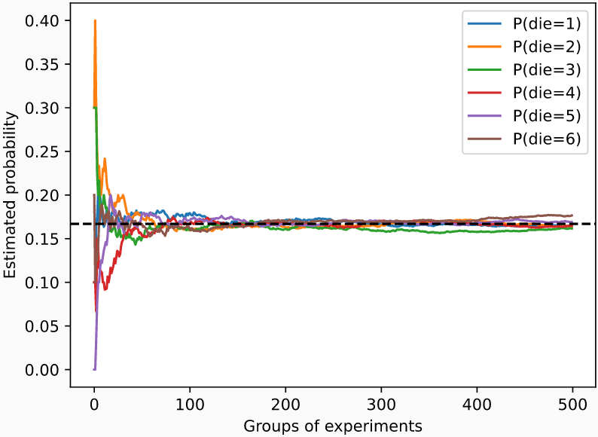
Basic Probability Theory
This procedure is as follows:
Calculate the cumulative sum along axis 0 (column axis)
Calculate the sum of each row (axis =1) in the cumulative sum of the previous step
Divide each element of the cumulative sum by the sum of the values of the element’s row
Plot the estimates of each value (element) along all the groups (i.e plot each column)
Create 500 groups, each group draws 10 samples
for i in range(6):
plt.plot(estimates[:,i].asnumpy(), label = ("P(die="+str(i+1)+")"))
1
2
3
4
5
6
Group 1
.1 | .2 | .2 | .2 | .0 | 0.3
0.25 | 0.15 | 0.15 | 0.2 | 0.1 | 0.15
0.266 | 0.133 | 0.2 | 0.133 | 0.1 | 0.166
Group 2
Group 3
. . .
Group 498
0.168 | 0.170 | 0.178 | 0.160 | 0.166 | 0.156
0.168 | 0.170 | 0.178 | 0.159 | 0.165 | 0.156
0.168 | 0.170 | 0.178 | 0.16 | 0.166 | 0.156
Group 499
Group 500

Slide 24
Basic Probability Theory
1
2
3
4
5
6
Group 1
.1 | .2 | .2 | .2 | .0 | 0.3
0.25 | 0.15 | 0.15 | 0.2 | 0.1 | 0.15
0.266 | 0.133 | 0.2 | 0.133 | 0.1 | 0.166
Group 2
Group 3
. . .
Group 498
0.168 | 0.170 | 0.178 | 0.160 | 0.166 | 0.156
0.168 | 0.170 | 0.178 | 0.159 | 0.165 | 0.156
0.168 | 0.170 | 0.178 | 0.16 | 0.166 | 0.156
Group 499
Group 500
Each solid curve corresponds to one of the six values of the die and gives our estimated probability that the die turns up that value as assessed after each group of experiments.
The dashed black line gives the true underlying probability.
As we get more data by conducting more experiments, the 6 solid curves converge towards the true probability.

Slide 25
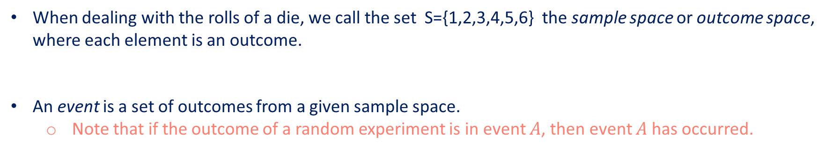
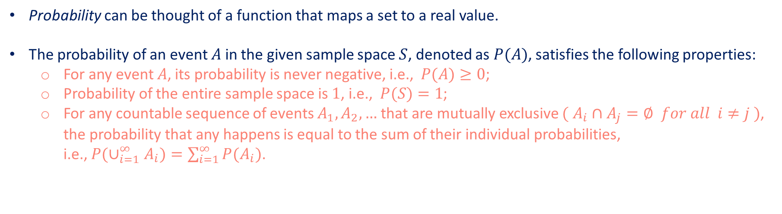
Basic Probability Theory: Axioms of Probability Theory
When dealing with the rolls of a die, we call the set S={1,2,3,4,5,6} the sample space or outcome space, where each element is an outcome.
An event is a set of outcomes from a given sample space.
Note that if the outcome of a random experiment is in event $A$, then event $A$ has occurred.
Probability can be thought of a function that maps a set to a real value.
The probability of an event $A$ in the given sample space $S$, denoted as $P(A)$, satisfies the following properties:
For any event $A$, its probability is never negative, i.e., $P(A)≥0$;
Probability of the entire sample space is $1$, i.e., $P(S)=1$;
For any countable sequence of events $A_{1},A_{2},…$ that are mutually exclusive $( A_{i}∩A_{j}=∅ for all i≠j )$, the probability that any happens is equal to the sum of their individual probabilities, i.e., $P(∪_{i=1}^{∞}A_{i})=\sum_{i=1}^{∞}{P(A_{i})}$.

Slide 26
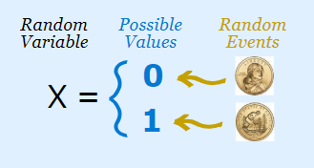
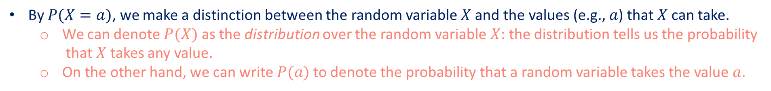
Basic Probability Theory: Random Variables
A random variable can be pretty much any quantity and is not deterministic.
It could take one value among a set of possibilities in a random experiment.
Src: https://towardsdatascience.com/understanding-random- variable-a618a2e99b93
By $P(X=a)$, we make a distinction between the random variable $X$ and the values (e.g., $a$) that $X$ can take.
We can denote $P(X)$ as the distribution over the random variable $X$: the distribution tells us the probability that $X$ takes any value.
On the other hand, we can write $P(a)$ to denote the probability that a random variable takes the value $a$.

Slide 27
Basic Probability Theory: Random Variables
We can specify a range of values for a random variable to take.
For example, $P(1≤X≤3)$ denotes the probability of the event $\{1≤X≤3\}$, which means $\{X=1,2,or,3\}$.
Equivalently, $P(1≤X≤3)$ represents the probability that the random variable $X$ can take a value from $\{1,2,3\}$.
There is a difference between discrete random variables (sides of a die), and continuous ones (weight and the height of a person).
For continuous random variables, It makes more sense to ask whether someone’s height falls into a given interval, say between 1.79 and 1.81 meters.
In these cases we quantify the likelihood that we see a value as a density.
In the interval between any two different heights we have nonzero probability.

Slide 28
Contents
CH2
Data Manipulation
Data Preprocessing
Linear Algebra
Linear Algebra cont.
Calculus
Automatic Differentiation
Probability
Documentation
Getting Started
Reading the Dataset
Scalars
Reduction
Derivatives and Differentiation
A Simple Example
Basic Probability Theory
Finding All the Functions and Classes in a Module
Operations
Handling Missing Data
Vectors
Dot Products
Partial Derivatives
Backward for Non-Scalar Variables
Dealing with Multiple Random Variables
Finding the Usage of Specific Functions and Classes
Broadcasting Mechanism
Conversion to the Tensor Format
Matrices
Matrix-Vector Products
Gradients
Detaching Computation
Expectation and Variance
Indexing and Slicing
Tensors
Matrix-Matrix Multiplication
Chain Rule
Computing the Gradient of Python Control Flow
Saving Memory
Basic Properties of Tensor Arithmetic
Norms
Conversion to Other Python Objects
+6 sections
More on Linear Algebra

Slide 29
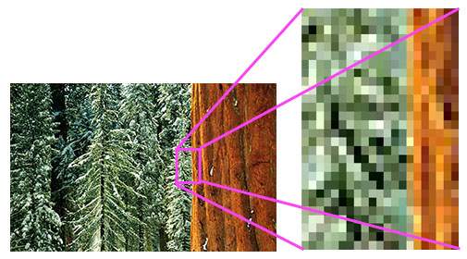
Dealing with Multiple Random Variables
Very often, we will want to consider more than one random variable at a time.
As an example, images contain millions of pixels, thus millions of random variables. And in many cases images will come with a label, identifying objects in the image.
We can think of the label, location, time, aperture, focal length, ISO, focus distance, and camera type as random variables.
Image pixels

Slide 30
Dealing with Multiple Random Variables
When we deal with multiple random variables, there are several quantities of interest.
Joint Probability
Conditional Probability
Bayes’ theorem
Marginalization
Independence
Application

Slide 31
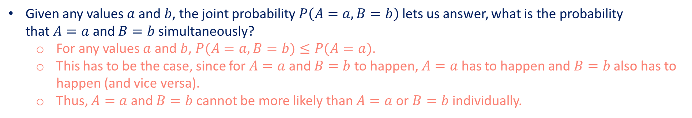
Dealing with Multiple Random Variables
Joint Probability
Conditional Probability
Bayes’ theorem
Marginalization
Independence
Application
Given any values $a$ and $b$, the joint probability $P\left(A=a, B=b\right)$lets us answer, what is the probability that $A=a$ and $B=b$ simultaneously?
For any values $a$ and $b$, $P(A=a,B=b)≤P(A=a)$.
This has to be the case, since for $A=a$ and $B=b$ to happen, $A=a$ has to happen and $B=b$ also has to happen (and vice versa).
Thus, $A=a$ and $B=b$ cannot be more likely than $A=a$ or $B=b$ individually.

Slide 32
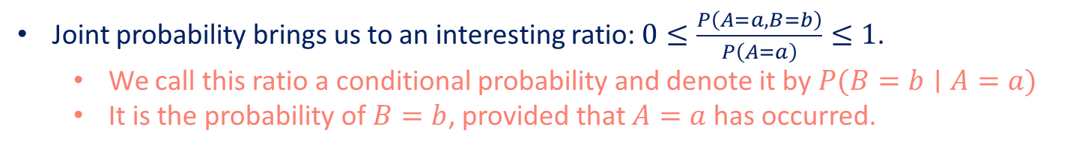



Dealing with Multiple Random Variables
Joint Probability
Conditional Probability
Bayes’ theorem
Marginalization
Independence
Application
Joint probability brings us to an interesting ratio: $0≤\frac{P\left(A=a,B=b\right)}{P\left(A=a\right)}≤1$.
We call this ratio a conditional probability and denote it by $P(B=b∣A=a)$
It is the probability of $B=b$, provided that $A=a$ has occurred.
B
B
B
A
A
A
Probability of $A$ known $B$ = 1
Probability of $A$ known $B$ = 0
Probability of $A$ known $B$ = $P(A,B)/P(B)$

Slide 33
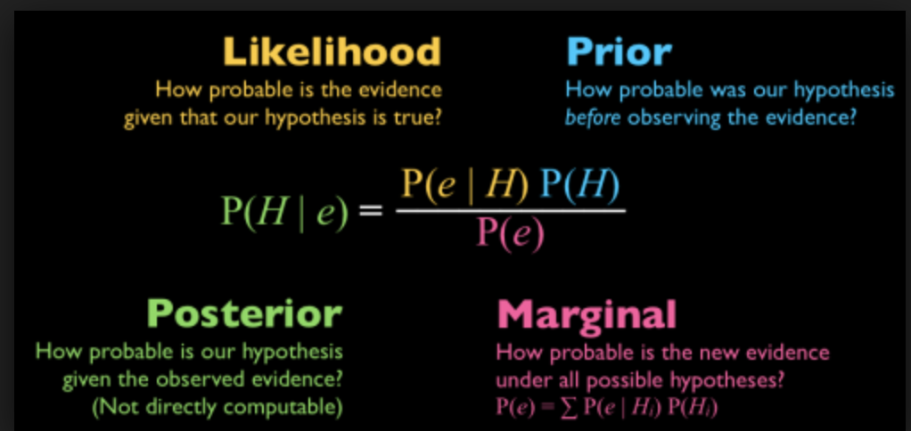
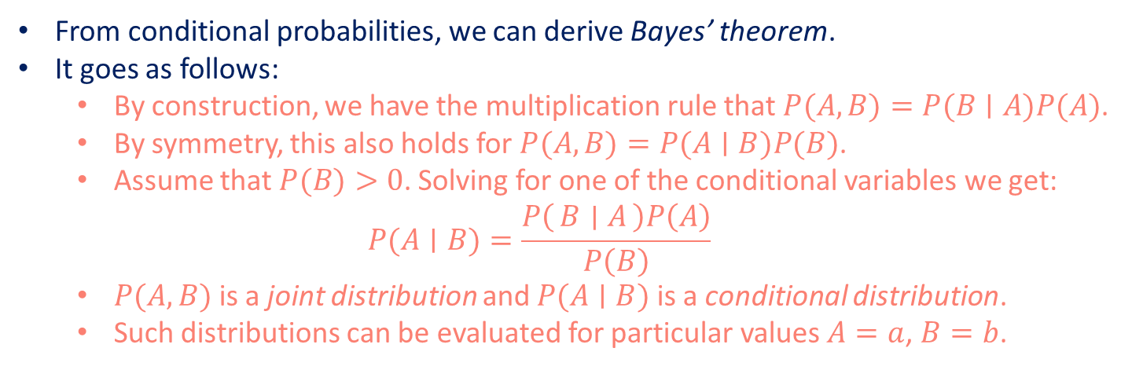
Dealing with Multiple Random Variables
Joint Probability
Conditional Probability
Bayes’ theorem
Marginalization
Independence
Application
From conditional probabilities, we can derive Bayes’ theorem.
It goes as follows:
By construction, we have the multiplication rule that $P(A,B)=P(B∣A)P(A)$.
By symmetry, this also holds for $P(A,B)=P(A∣B)P(B)$.
Assume that $P(B)>0$. Solving for one of the conditional variables we get: $P(A∣B)=\frac{P\left(B ∣ A\right)P\left(A\right)}{P\left(B\right)}$
$P(A,B)$ is a joint distribution and $P(A∣B)$ is a conditional distribution.
Such distributions can be evaluated for particular values $A=a$, $B=b$.
Bayesian Statistics

Slide 34
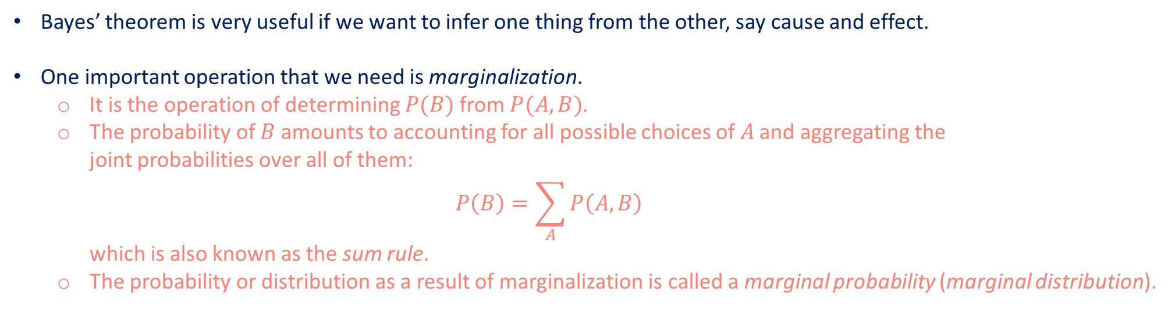
Dealing with Multiple Random Variables
Joint Probability
Conditional Probability
Bayes’ theorem
Marginalization
Independence
Application
Bayes’ theorem is very useful if we want to infer one thing from the other, say cause and effect.
One important operation that we need is marginalization.
It is the operation of determining $P(B)$ from $P(A,B)$.
The probability of $B$ amounts to accounting for all possible choices of $A$ and aggregating the joint probabilities over all of them: $P\left(B\right)=\sum_{A}{P\left(A,B\right) }$ which is also known as the sum rule.
The probability or distribution as a result of marginalization is called a marginal probability (marginal distribution).

Slide 35
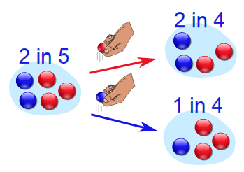
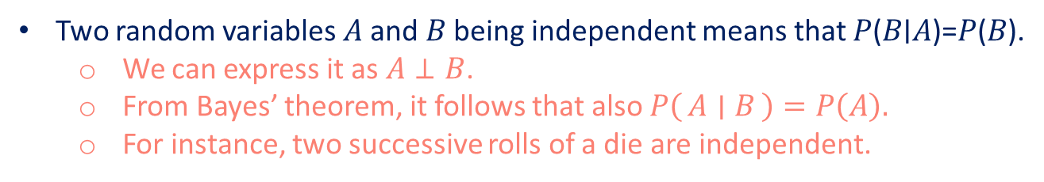
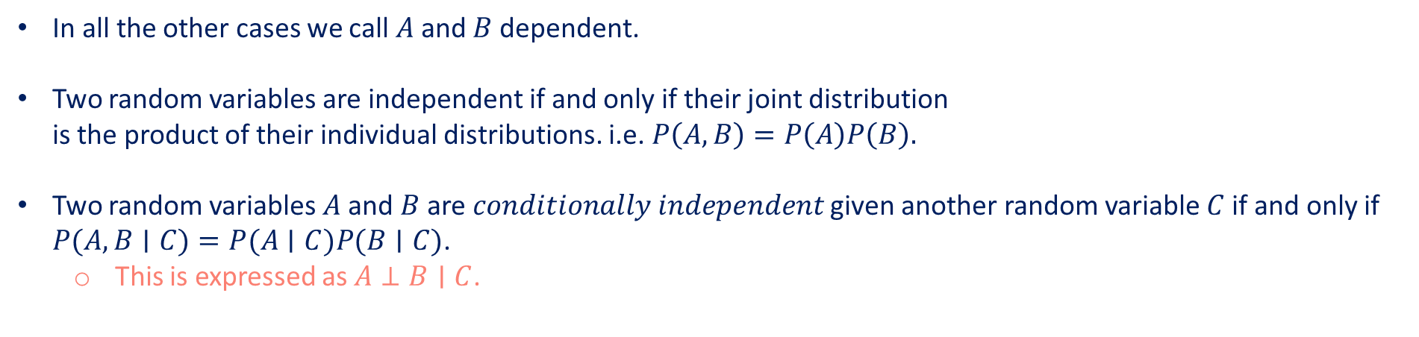
Dealing with Multiple Random Variables
Joint Probability
Conditional Probability
Bayes’ theorem
Marginalization
Independence
Application
Two random variables 𝐴 and 𝐵 being independent means that 𝑃(𝐵∣𝐴)=𝑃(𝐵).
We can express it as $A⊥B$.
From Bayes’ theorem, it follows that also $P\left(A ∣ B\right)=P\left(A\right).$
For instance, two successive rolls of a die are independent.
In all the other cases we call $A$ and $B$ dependent.
Two random variables are independent if and only if their joint distribution is the product of their individual distributions. i.e. $P\left(A,B\right)=P\left(A\right)P\left(B\right).$
Two random variables $A$ and $B$ are $conditionally independent$ given another random variable $C$ if and only if $P(A,B∣C)=P(A∣C)P(B∣C)$.
This is expressed as $A⊥B∣C$.
Definition of Dependent Event

Slide 36
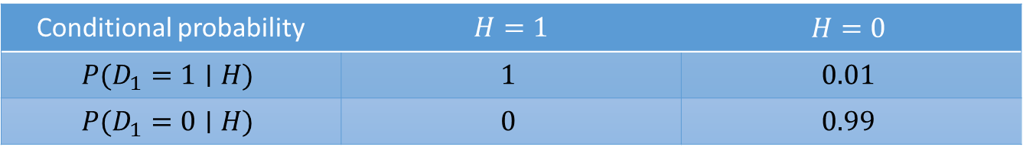

Dealing with Multiple Random Variables
Joint Probability
Conditional Probability
Bayes’ theorem
Marginalization
Independence
Application
Assume that a doctor administers an HIV test to a patient. This test is fairly accurate and it fails only with 1% probability if the patient is healthy but reporting him as diseased. Moreover, it never fails to detect HIV if the patient actually has it.
Conditional probability | $$H=1$$ | $$H=0$$
$$P(D_{1}=1∣H)$$ | $$1$$ | $$0.01$$
$$P(D_{1}=0∣H)$$ | $$0$$ | $$0.99$$
Conditional probability of $P(D_{1}∣H)$.
Let us work out the probability of the patient having HIV if the test comes back positive, i.e., $P\left(H=1 ∣ D_{1}=1\right)$.
Assume that the population is quite healthy, e.g., $P(H=1)=0.0015$.

Slide 37
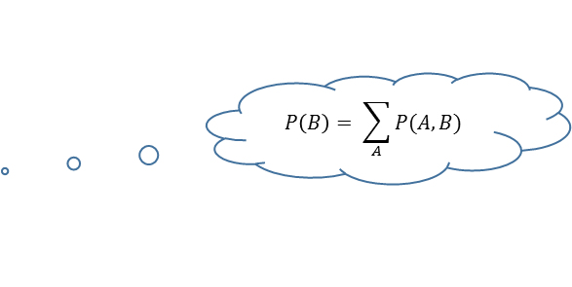
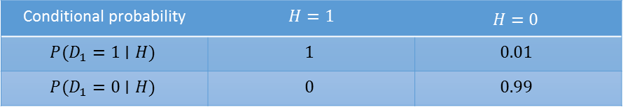
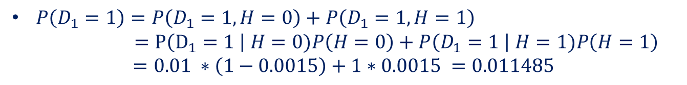



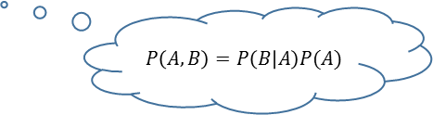
Dealing with Multiple Random Variables
Joint Probability
Conditional Probability
Bayes’ theorem
Marginalization
Independence
Application
$$P\left(A | B\right)=\frac{P\left(B | A\right)P(A)}{P\left(B\right)}$$
Conditional probability | $$H=1$$ | $$H=0$$
$$P(D_{1}=1∣H)$$ | $$1$$ | $$0.01$$
$$P(D_{1}=0∣H)$$ | $$0$$ | $$0.99$$
$P\left(H=1 ∣ D_{1}=1\right)=\frac{P\left(D_{1}=1 \right| H=1)P\left(H=1\right)}{P\left(D_{1}=1\right)}$
$P\left(D_{1}=1\right)$ is unknown. So, apply marginalization and the multiplication rule.
$$P\left(B\right)= \sum_{A}{P(A,B)}$$
$P\left(D_{1}=1\right)=P\left(D_{1}=1, H=0\right)+P\left(D_{1}=1, H=1\right)$ $=P\left(D_{1}=1 \right| H=0)P\left(H=0\right)+P\left(D_{1}=1 \right| H=1)P\left(H=1\right)$ $=0.01 ∗\left(1−0.0015\right)+1∗0.0015 =0.011485$
$$P\left(A,B\right)=P\left(B | A\right)P(A)$$
So, $P\left(H=1 \right|D_{1}=1)=\frac{1 ∗0.0015}{0.011485}=0.1306$

Slide 38
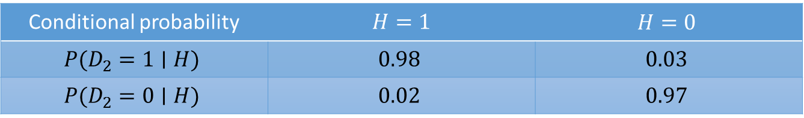

Dealing with Multiple Random Variables
Joint Probability
Conditional Probability
Bayes’ theorem
Marginalization
Independence
Application
For another diagnostic, we have
Conditional probability | $$H=1$$ | $$H=0$$
$$P(D_{2}=1∣H)$$ | $$0.98$$ | $$0.03$$
$$P(D_{2}=0∣H)$$ | $$0.02$$ | $$0.97$$
Conditional probability of $P(D_{2}∣H)$.
Let us work out the requisite probabilities to invoke Bayes’ theorem by assuming the conditional independence

Slide 39
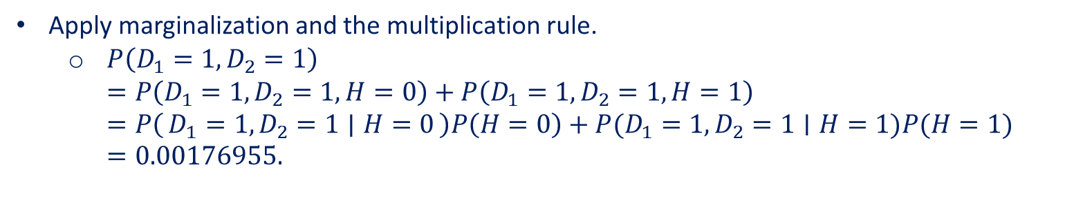
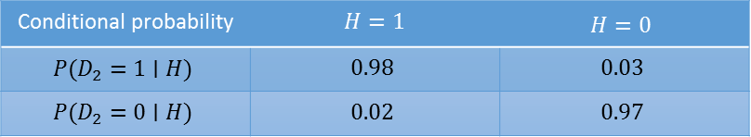
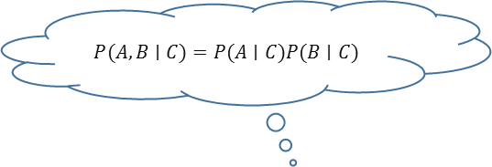
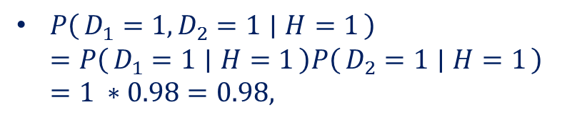
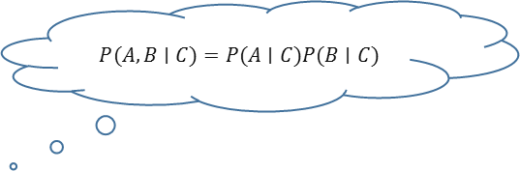
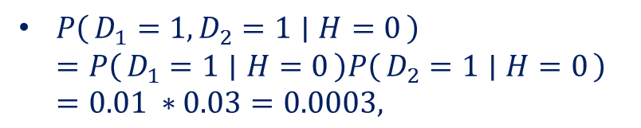
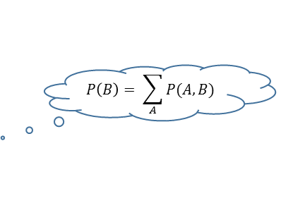
Dealing with Multiple Random Variables
Joint Probability
Conditional Probability
Bayes’ theorem
Marginalization
Independence
Application
Conditional probability | $$H=1$$ | $$H=0$$
$$P(D_{2}=1∣H)$$ | $$0.98$$ | $$0.03$$
$$P(D_{2}=0∣H)$$ | $$0.02$$ | $$0.97$$
$$P(A,B∣C)=P(A∣C)P(B∣C)$$
$$P(A,B∣C)=P(A∣C)P(B∣C)$$
$P\left(D_{1}=1,D_{2}=1 ∣ H=0\right)$ $=P\left(D_{1}=1 ∣ H=0\right)P\left(D_{2}=1 ∣ H=0\right)$ $=0.01 ∗0.03=0.0003,$
$P\left(D_{1}=1,D_{2}=1 ∣ H=1\right)$ $=P\left(D_{1}=1 ∣ H=1\right)P\left(D_{2}=1 ∣ H=1\right)$ $=1 ∗0.98=0.98,$
Apply marginalization and the multiplication rule.
$P\left(D_{1}=1,D_{2}=1\right)$ $=P\left(D_{1}=1,D_{2}=1,H=0\right)+P\left(D_{1}=1,D_{2}=1,H=1\right)$ $=P\left(D_{1}=1,D_{2}=1 ∣ H=0\right)P\left(H=0\right)+P(D_{1}=1,D_{2}=1∣H=1)P(H=1)$ $=0.00176955.$
$$P\left(B\right)= \sum_{A}{P(A,B)}$$

Slide 40
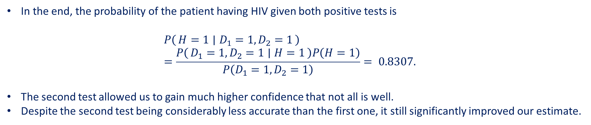
Dealing with Multiple Random Variables
Joint Probability
Conditional Probability
Bayes’ theorem
Marginalization
Independence
Application
Conditional probability | $$H=1$$ | $$H=0$$
$$P(D_{2}=1∣H)$$ | $$0.98$$ | $$0.03$$
$$P(D_{2}=0∣H)$$ | $$0.02$$ | $$0.97$$
In the end, the probability of the patient having HIV given both positive tests is $P\left(H=1 ∣ D_{1}=1,D_{2}=1\right)$ $=\frac{P\left(D_{1}=1,D_{2}=1 ∣ H=1\right)P\left(H=1\right)}{P\left(D_{1}=1,D_{2}=1\right)}= 0.8307.$
The second test allowed us to gain much higher confidence that not all is well.
Despite the second test being considerably less accurate than the first one, it still significantly improved our estimate.

Slide 41
Contents
CH2
Data Manipulation
Data Preprocessing
Linear Algebra
Linear Algebra cont.
Calculus
Automatic Differentiation
Probability
Documentation
Getting Started
Reading the Dataset
Scalars
Reduction
Derivatives and Differentiation
A Simple Example
Basic Probability Theory
Finding All the Functions and Classes in a Module
Operations
Handling Missing Data
Vectors
Dot Products
Partial Derivatives
Backward for Non-Scalar Variables
Dealing with Multiple Random Variables
Finding the Usage of Specific Functions and Classes
Broadcasting Mechanism
Conversion to the Tensor Format
Matrices
Matrix-Vector Products
Gradients
Detaching Computation
Expectation and Variance
Indexing and Slicing
Tensors
Matrix-Matrix Multiplication
Chain Rule
Computing the Gradient of Python Control Flow
Saving Memory
Basic Properties of Tensor Arithmetic
Norms
Conversion to Other Python Objects
+6 sections
More on Linear Algebra

Slide 42

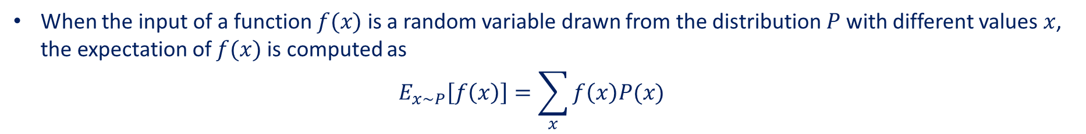
Expectation and Variance
The expectation (or average) of the random variable $X$ is denoted as $E\left[X\right]=\sum_{x}{xP(X=x)}$
When the input of a function $f(x)$ is a random variable drawn from the distribution $P$ with different values$x$, the expectation of $f(x)$ is computed as $E_{x\sim P}\left[f\left(x\right)\right]=\sum_{x}{f\left(x\right)P(x)}$
To measure by how much the random variable $X$ deviates from its expectation. This can be quantified by the variance $Var\left[X\right]=E[(X−E{\left[X\right])]}^{2}=E\left[X^{2}\right]−E{\left[X\right]}^{2}$
Standard deviation is the square root of the variance.
The variance of a function of a random variable measures by how much the function deviates from the expectation of the function, as different values x of the random variable are sampled from its distribution: $Var\left[f(x)\right]=E[{\left(f\left(x\right)−E\left[f\left(x\right)\right]\right)}^{2}]$

Slide 43
Summary
We can sample from probability distributions.
We can analyze multiple random variables using joint distribution, conditional distribution, Bayes’ theorem, marginalization, and independence assumptions.
Expectation and variance offer useful measures to summarize key characteristics of probability distributions.

Slide 44
Contents
CH2
Data Manipulation
Data Preprocessing
Linear Algebra
Linear Algebra cont.
Calculus
Automatic Differentiation
Probability
Documentation
Getting Started
Reading the Dataset
Scalars
Reduction
Derivatives and Differentiation
A Simple Example
Basic Probability Theory
Finding All the Functions and Classes in a Module
Operations
Handling Missing Data
Vectors
Dot Products
Partial Derivatives
Backward for Non-Scalar Variables
Dealing with Multiple Random Variables
Finding the Usage of Specific Functions and Classes
Broadcasting Mechanism
Conversion to the Tensor Format
Matrices
Matrix-Vector Products
Gradients
Detaching Computation
Expectation and Variance
Indexing and Slicing
Tensors
Matrix-Matrix Multiplication
Chain Rule
Computing the Gradient of Python Control Flow
Saving Memory
Basic Properties of Tensor Arithmetic
Norms
Conversion to Other Python Objects
+6 sections
More on Linear Algebra

Slide 45
Finding All the Functions and Classes in a Module
The API documentation and additional tutorials and examples provide plenty of documentation beyond the book.
In this section we provide you with some guidance to exploring the MXNet API.
In order to know which functions and classes can be called in a module, we invoke the dir function.
For instance, we can query all properties in the module for generating random numbers:
from mxnet import np
print(dir(np.random))
For more specific instructions on how to use a given function or class, we can invoke the help function.
As an example, let us explore the usage instructions for tensors’ ones function.
help(np.ones)
In the Jupyter notebook, we can use ? to display the document in another window.
For example, list? will create content that is almost identical to help(list), displaying it in a new browser window.
If we use two question marks, such as list??, the Python code implementing the function will also be displayed.

